Slide 1
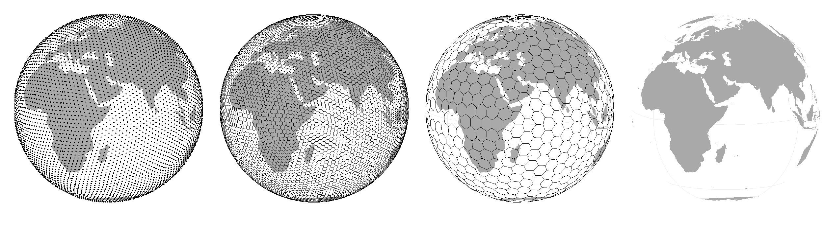
Community composition, species associations
Petr Keil
Notes:
Hi, my name is Petr Keil and this is my project Biodiversity dynamics across a continuum of space, time, and their scales.

Slide 2
Community matrices
Notes:
I am qualified to deliver all this

Slide 3
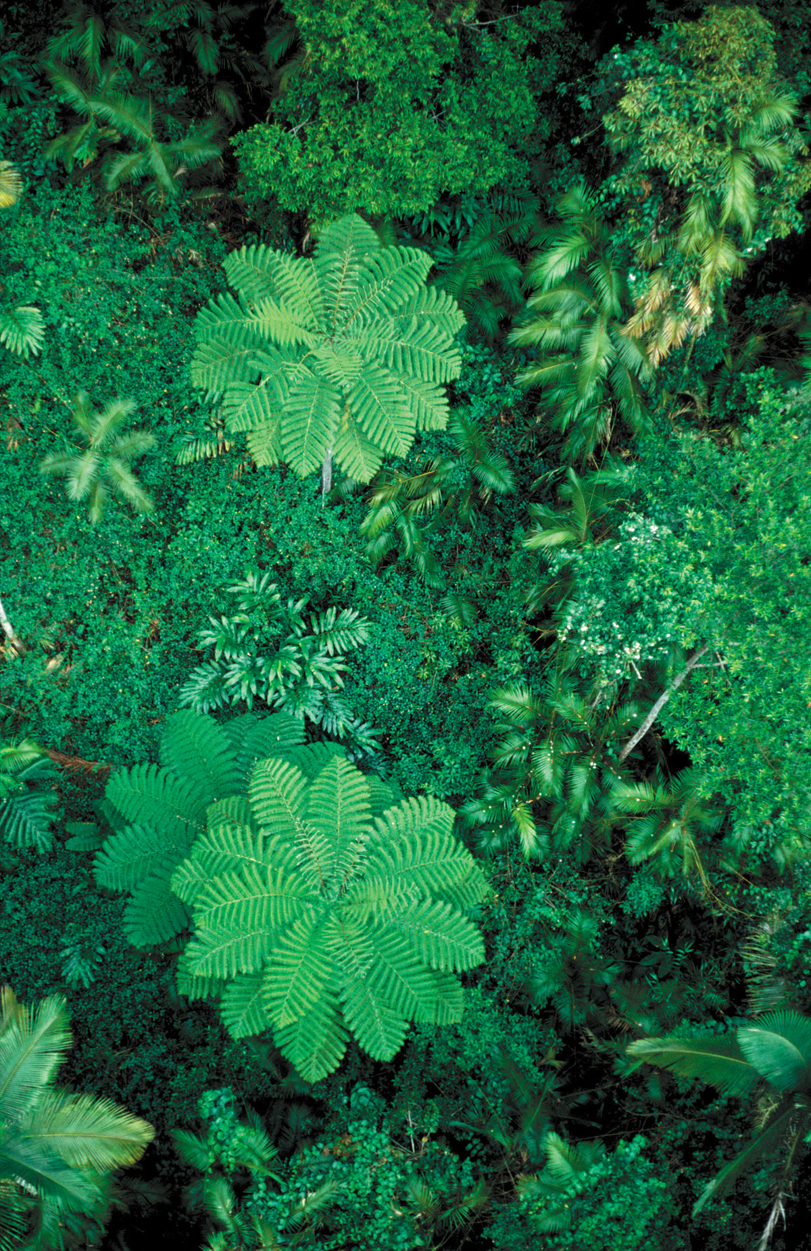
From natural communities to community matrix
Natural Community
Community Surveys
Community matrix
(filled with abundances)
Sites
S1
S2
S3
S4
S5
S6
1
2
Sp1
1
0
0
0
0
1
Sp2
1
0
0
0
0
1
Species
1
0
0
0
0
1
Sp3
4
Sp4
4
6
1
0
0
0
3
Sp5
0
0
3
2
3
0
5
6
Notes:
In this panel we can probably all agree that biodiversity is one of the most valuable natural resources.
But things like climate change or habitat loss are a threat to biodiversity, to the extent that we hear about biodiversity crisis, or sixth mass extinction
For example, about 1% of vertebrate species have gone extinct because of humans

Slide 4
Pairwise similarity between sites
Community matrix
(filled with presences/absences)
Sites
S1
S2
S3
S4
S5
S6
Sp1
1
0
0
0
0
1
Sp2
1
0
0
0
0
1
Species
1
0
0
0
0
1
Sp3
Sp4
1
1
1
0
0
0
Sp5
0
0
1
1
1
0
Side note:
Recall what is alpha, beta, and gamma diversity, and how they relate to this matrix. Specifically:
α … average species richness per site
γ … total number of species in the matrix (# of rows)
β=γ/α
Pairwise
similarity
Notes:
In this panel we can probably all agree that biodiversity is one of the most valuable natural resources.
But things like climate change or habitat loss are a threat to biodiversity, to the extent that we hear about biodiversity crisis, or sixth mass extinction
For example, about 1% of vertebrate species have gone extinct because of humans

Slide 5
Pairwise similarity between sites
Similarity
1
1
1
1
1
Sites
1
1
1
1
1
1
1
1
1
1
Sites
Species
1
1
1
1
1
1
1
1
1
1
Sites
Species
1
1
1
1
1
Species
Notes:
In this panel we can probably all agree that biodiversity is one of the most valuable natural resources.
But things like climate change or habitat loss are a threat to biodiversity, to the extent that we hear about biodiversity crisis, or sixth mass extinction
For example, about 1% of vertebrate species have gone extinct because of humans

Slide 6
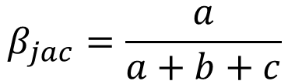
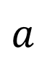
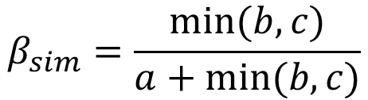
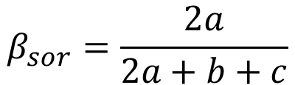
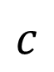
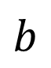
Pairwise similarity between sites: Jaccard, Sorensen, and Simpson indices
$$β_{jac}=\frac{a}{a+b+c}$$
$$b$$
1
1
1
1
1
$$β_{sor}=\frac{2a}{2a+b+c}$$
Sites
1
1
1
1
1
$$a$$
Species
$$β_{sim}=\frac{min⁡(b,c)}{a+min⁡(b,c)}$$
$$c$$
Legendre & Legendre (2012) Numerical Ecology
Koleff et al. (2003) J. Anim. Ecol.
Notes:
In this panel we can probably all agree that biodiversity is one of the most valuable natural resources.
But things like climate change or habitat loss are a threat to biodiversity, to the extent that we hear about biodiversity crisis, or sixth mass extinction
For example, about 1% of vertebrate species have gone extinct because of humans

Slide 7
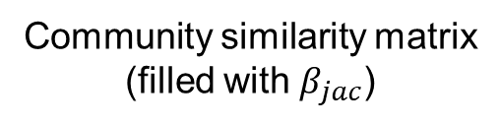
From natural communities to similarity matrices
Community matrix
(filled with presences/absences)
Community similarity matrix
(filled with $β_{jac}$)
Sites
S1
S2
S3
S4
S5
S6
Sp1
1
0
0
0
0
1
S2
Sp2
1
0
0
0
0
1
S3
S4
Species
1
0
0
0
0
1
Sites
Sp3
S5
Sp4
1
1
1
0
0
0
S6
Sp5
0
0
1
1
1
0
S1
S2
S3
S4
S5
Sites
Pairwise
similarity
Notes:
In this panel we can probably all agree that biodiversity is one of the most valuable natural resources.
But things like climate change or habitat loss are a threat to biodiversity, to the extent that we hear about biodiversity crisis, or sixth mass extinction
For example, about 1% of vertebrate species have gone extinct because of humans

Slide 8
You should know
Natural communities can be represented by community matrices, which consist of either abundances or presences/absences of S species at N sites
Similarity between two sites can be measured by pairwise similarity indices, e.g. Jaccard index
Similairity = 1 – dissimilarity, and vice versa
Similarity between all sites in a community can be represented by triangular similarity matrix, which is a case of distance matrix
Notes:
In this panel we can probably all agree that biodiversity is one of the most valuable natural resources.
But things like climate change or habitat loss are a threat to biodiversity, to the extent that we hear about biodiversity crisis, or sixth mass extinction
For example, about 1% of vertebrate species have gone extinct because of humans

Slide 9
Similarity vs geographical and environmental distance
Notes:
I am qualified to deliver all this

Slide 10
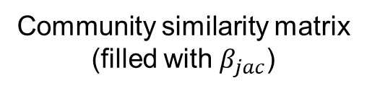
Community similarity vs geographic distance
Community similarity matrix
(filled with $β_{jac}$)
Geographic distance matrix
(filled with distances in m, or km)
1
2
S2
S2
S3
S3
3
4
S4
S4
Sites
Sites
S5
S5
S6
S6
5
6
S1
S2
S3
S4
S5
S1
S2
S3
S4
S5
Sites
Sites
Notes:
In this panel we can probably all agree that biodiversity is one of the most valuable natural resources.
But things like climate change or habitat loss are a threat to biodiversity, to the extent that we hear about biodiversity crisis, or sixth mass extinction
For example, about 1% of vertebrate species have gone extinct because of humans

Slide 11
What if we plot community similarity vs geographic distance
The first law of geography, also known as the distance decay of similarity:
- Similarity between two observations decreases (decays) with the distance between observations
Tobler (1970) Econ. Geogr.
Nekola & White (1999) Journal of Biogeography
Notes:
In this panel we can probably all agree that biodiversity is one of the most valuable natural resources.
But things like climate change or habitat loss are a threat to biodiversity, to the extent that we hear about biodiversity crisis, or sixth mass extinction
For example, about 1% of vertebrate species have gone extinct because of humans

Slide 12
What if we plot community similarity vs geographic distance
Note that here I show dissimilarity, which is 1-similarity.
Keil et al. (2012) Journal of Biogeography
Notes:
In this panel we can probably all agree that biodiversity is one of the most valuable natural resources.
But things like climate change or habitat loss are a threat to biodiversity, to the extent that we hear about biodiversity crisis, or sixth mass extinction
For example, about 1% of vertebrate species have gone extinct because of humans

Slide 13
Community similarity vs geographic distance vs similarity of environment
Similarity of environment
Community similarity matrix
(filled with $β_{jac}$)
Geographic distance matrix
(filled with distances in m, or km)
S2
S2
S2
S3
S3
S3
S4
S4
S4
Sites
Sites
Sites
S5
S5
S5
S6
S6
S6
S1
S2
S3
S4
S5
S1
S2
S3
S4
S5
S1
S2
S3
S4
S5
Sites
Sites
Sites
Cottenie (2005) Ecology Letters
Notes:
In this panel we can probably all agree that biodiversity is one of the most valuable natural resources.
But things like climate change or habitat loss are a threat to biodiversity, to the extent that we hear about biodiversity crisis, or sixth mass extinction
For example, about 1% of vertebrate species have gone extinct because of humans

Slide 14
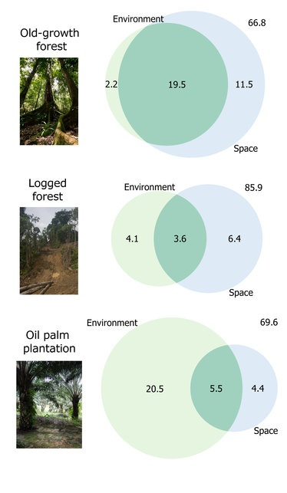
Community similarity vs geographic distance vs similarity of environment
Keil et al. (2012) Journal of Biogeography
Wearn et al. (2018) Journal of Animal Ecology
Notes:
In this panel we can probably all agree that biodiversity is one of the most valuable natural resources.
But things like climate change or habitat loss are a threat to biodiversity, to the extent that we hear about biodiversity crisis, or sixth mass extinction
For example, about 1% of vertebrate species have gone extinct because of humans

Slide 15
You should know
Similarity of species composition decreases with geographic distance, following what is called a distance decay of similarity, a.k.a first law of geography
Similarity of species composition also decreases with environmental similarity. The more environmentally dissimilar two sites are, the more dissimilar their species composition
These two effects can be partitioned
If distance is more important, we usually conclude that dispersal limitations shape the communities
If environment is more important, we usually conclude that niche processes shape the communities
Notes:
In this panel we can probably all agree that biodiversity is one of the most valuable natural resources.
But things like climate change or habitat loss are a threat to biodiversity, to the extent that we hear about biodiversity crisis, or sixth mass extinction
For example, about 1% of vertebrate species have gone extinct because of humans

Slide 16
From similarity to ordination and cluster analysis
Notes:
I am qualified to deliver all this

Slide 17
Cluster analysis
Similarity among sites
S2
S3
S4
Community Matrix
Sites
S5
Sites
S6
S1
S2
S3
S4
S5
S6
Sp1
S1
S2
S3
S4
S5
1
0
0
0
0
1
Sp2
1
0
0
0
0
1
Sites
Species
1
0
0
0
0
1
Sp3
Sp4
4
6
1
0
0
0
Sp5
0
0
3
2
3
0
Leps & Smilauer (2003)
Notes:
In this panel we can probably all agree that biodiversity is one of the most valuable natural resources.
But things like climate change or habitat loss are a threat to biodiversity, to the extent that we hear about biodiversity crisis, or sixth mass extinction
For example, about 1% of vertebrate species have gone extinct because of humans

Slide 18
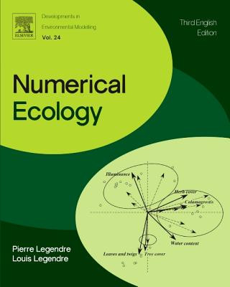
Ordination analysis
Leps & Smilauer (2003)
Legendre & Legendre (2012)
Notes:
In this panel we can probably all agree that biodiversity is one of the most valuable natural resources.
But things like climate change or habitat loss are a threat to biodiversity, to the extent that we hear about biodiversity crisis, or sixth mass extinction
For example, about 1% of vertebrate species have gone extinct because of humans

Slide 19
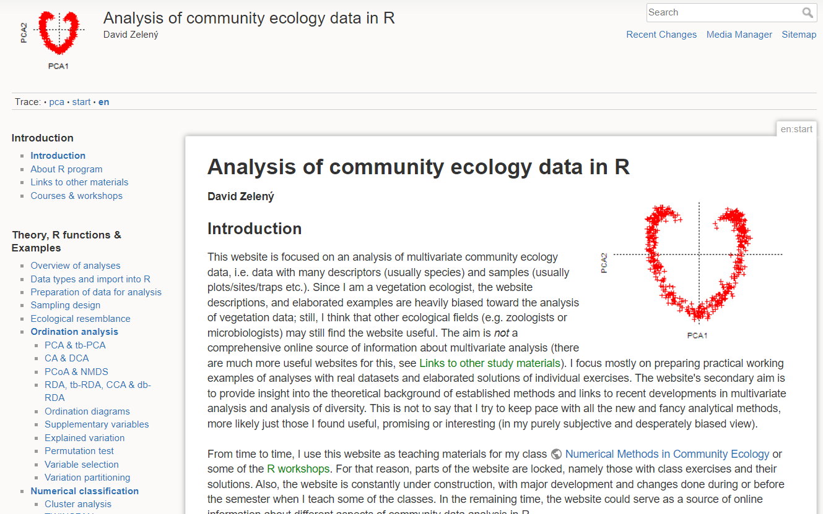
Ordination analysis
David Zelený: https://www.davidzeleny.net/anadat-r/doku.php/en:start
Notes:
In this panel we can probably all agree that biodiversity is one of the most valuable natural resources.
But things like climate change or habitat loss are a threat to biodiversity, to the extent that we hear about biodiversity crisis, or sixth mass extinction
For example, about 1% of vertebrate species have gone extinct because of humans

Slide 20
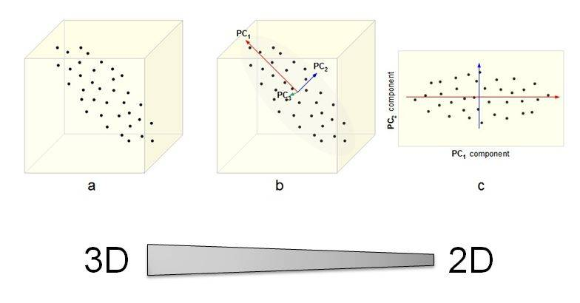
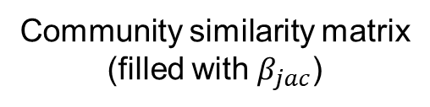
Principal components analysis (PCA)
Community similarity matrix
(filled with $β_{jac}$)
S2
S3
S4
Sites
S5
S6
S1
S2
S3
S4
S5
Sites
David Zelený: https://www.davidzeleny.net/anadat-r/doku.php/en:start
Notes:
In this panel we can probably all agree that biodiversity is one of the most valuable natural resources.
But things like climate change or habitat loss are a threat to biodiversity, to the extent that we hear about biodiversity crisis, or sixth mass extinction
For example, about 1% of vertebrate species have gone extinct because of humans

Slide 21
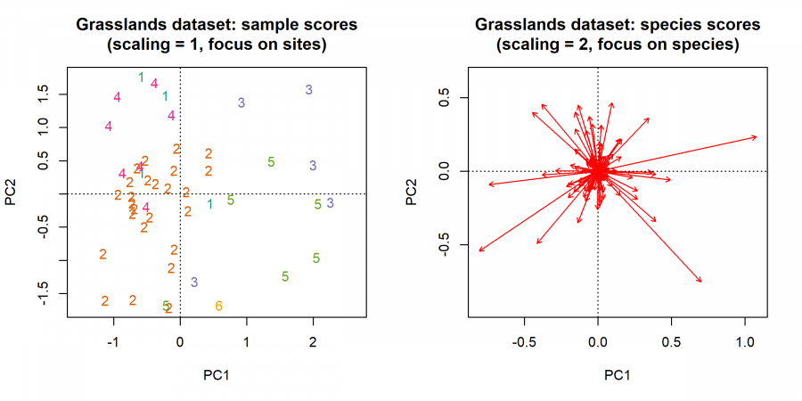
Principal components analysis (PCA)
David Zelený: https://www.davidzeleny.net/anadat-r/doku.php/en:start
Notes:
In this panel we can probably all agree that biodiversity is one of the most valuable natural resources.
But things like climate change or habitat loss are a threat to biodiversity, to the extent that we hear about biodiversity crisis, or sixth mass extinction
For example, about 1% of vertebrate species have gone extinct because of humans

Slide 22
Redundancy analysis (RDA) – when environmental data are available
Community Matrix
Sites
S1
S2
S3
S4
S5
S6
Sp1
1
0
0
0
0
1
Sp2
1
0
0
0
0
1
Species
1
0
0
0
0
1
Sp3
Sp4
4
6
1
0
0
0
Sp5
0
0
3
2
3
0
Sites
S1
S2
S3
S4
S5
S6
Temp
4
3
1
2
0
0
Humid
4
0
3
2
3
0
Leps & Smilauer (2003)
Notes:
In this panel we can probably all agree that biodiversity is one of the most valuable natural resources.
But things like climate change or habitat loss are a threat to biodiversity, to the extent that we hear about biodiversity crisis, or sixth mass extinction
For example, about 1% of vertebrate species have gone extinct because of humans

Slide 23
Canonical correspondence analysis (CCA) – when species have environmental optima
Community Matrix
Sites
S1
S2
S3
S4
S5
S6
Sp1
1
0
0
0
0
1
Sp2
1
0
0
0
0
1
Species
1
0
0
0
0
1
Sp3
Sp4
4
6
1
0
0
0
Sp5
0
0
3
2
3
0
Sites
S1
S2
S3
S4
S5
S6
Temp
4
3
1
2
0
0
Humid
4
0
3
2
3
0
Leps & Smilauer (2003)
Notes:
In this panel we can probably all agree that biodiversity is one of the most valuable natural resources.
But things like climate change or habitat loss are a threat to biodiversity, to the extent that we hear about biodiversity crisis, or sixth mass extinction
For example, about 1% of vertebrate species have gone extinct because of humans

Slide 24
Geographic regionalization – an empirical large-scale example analysis
Kreft & Jetz (2010) Journal of Biogeography
Notes:
In this panel we can probably all agree that biodiversity is one of the most valuable natural resources.
But things like climate change or habitat loss are a threat to biodiversity, to the extent that we hear about biodiversity crisis, or sixth mass extinction
For example, about 1% of vertebrate species have gone extinct because of humans

Slide 25
Geographic regionalization – an empirical large-scale example analysis
Global mammals – first two ordination axes mapped
Kreft & Jetz (2010) Journal of Biogeography
Notes:
In this panel we can probably all agree that biodiversity is one of the most valuable natural resources.
But things like climate change or habitat loss are a threat to biodiversity, to the extent that we hear about biodiversity crisis, or sixth mass extinction
For example, about 1% of vertebrate species have gone extinct because of humans

Slide 26
Geographic regionalization – an empirical large-scale example analysis
Wallace (1876)
Kreft & Jetz (2010) - based on 4954 mammal species
Kreft & Jetz (2010) Journal of Biogeography
Notes:
In this panel we can probably all agree that biodiversity is one of the most valuable natural resources.
But things like climate change or habitat loss are a threat to biodiversity, to the extent that we hear about biodiversity crisis, or sixth mass extinction
For example, about 1% of vertebrate species have gone extinct because of humans

Slide 27
You should know
Similarity matrix can be subjected to ordination analysis, or cluster analysis
Ordinations look for the longest gradients (axes) in the space delineated by the similarities
Cluster analysis seeks clusters of communities with similar species composition
These can be used to delineate areas with similar species composition, e.g. biogeographic regions
Ordinations are the main analytical tool in many sub-fields of ecology, and they enable analyses of complex multi-dimensional data. A typical application is to assess which environmental conditions affect species composition, and which species in particular.
Notes:
In this panel we can probably all agree that biodiversity is one of the most valuable natural resources.
But things like climate change or habitat loss are a threat to biodiversity, to the extent that we hear about biodiversity crisis, or sixth mass extinction
For example, about 1% of vertebrate species have gone extinct because of humans

Slide 28
Species associations
Notes:
I am qualified to deliver all this

Slide 29
Interspecific association vs conspecific aggregation
Keil et al. (2020) Ecological Monographs
Notes:
In this panel we can probably all agree that biodiversity is one of the most valuable natural resources.
But things like climate change or habitat loss are a threat to biodiversity, to the extent that we hear about biodiversity crisis, or sixth mass extinction
For example, about 1% of vertebrate species have gone extinct because of humans

Slide 30
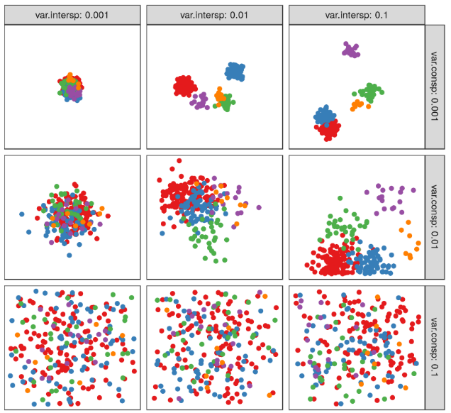
Interspecific association vs conspecific aggregation
Keil et al. (2020) Ecological Monographs
Notes:
In this panel we can probably all agree that biodiversity is one of the most valuable natural resources.
But things like climate change or habitat loss are a threat to biodiversity, to the extent that we hear about biodiversity crisis, or sixth mass extinction
For example, about 1% of vertebrate species have gone extinct because of humans

Slide 31
Measuring interspecific association in community matrix
Sites
S1
S2
S3
S4
S5
S6
Sp1
1
0
0
0
0
1
Covariance
Forbes’s association (Forbes 1907)
C-score (Stone & Roberts 1990)
Togetherness (Stone & Roberts 1992)
Percentage overlap (Araujo & Rosenfeld 2014)
1
2
Sp2
1
0
0
0
0
1
Species
1
0
0
0
0
1
Sp3
Sp4
4
6
1
0
0
0
3
4
Sp5
0
0
3
2
3
0
5
6
β_{Jaccard}
β_{Sim}
β_{Sor}
Keil et al. (2020) Ecological Monographs
Notes:
In this panel we can probably all agree that biodiversity is one of the most valuable natural resources.
But things like climate change or habitat loss are a threat to biodiversity, to the extent that we hear about biodiversity crisis, or sixth mass extinction
For example, about 1% of vertebrate species have gone extinct because of humans

Slide 32
Measuring interspecific association in community matrix
Similarity among sites
S2
Sites
S3
S1
S2
S3
S4
S5
S6
S4
Sites
Sp1
1
0
0
0
0
1
S5
Sp2
1
0
0
0
0
1
S6
Species
S1
S2
S3
S4
S5
Sp3
1
0
0
0
0
1
Sites
Sp4
4
6
1
0
0
0
Similarity among species
Sp5
0
0
3
2
3
0
Sp2
Sp3
Species
Sp4
Sp5
Sp1
Sp2
Sp3
Sp4
Keil et al. (2020) Ecological Monographs
Species
Notes:
In this panel we can probably all agree that biodiversity is one of the most valuable natural resources.
But things like climate change or habitat loss are a threat to biodiversity, to the extent that we hear about biodiversity crisis, or sixth mass extinction
For example, about 1% of vertebrate species have gone extinct because of humans

Slide 33
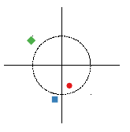
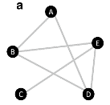
Interspecific associations - many schools of thought
Assembly rules
Coexistence theory
Cody & Diamond
1975
Ulrich & Gotelli
2010
Phytocenology
Ordinations
Braun-Blanquet
1964
ter Braak
1988
Networks
May 1973
Morueta-Holme 2016
Geostatistics
Wagner
2003
McGlinn & Hurlbert
2018
Point pattern
analysis
Wiegand & Moloney
2014
C-scores
PCA, MDS (PCoA)
Connectance
Community
variogram
Bivariate pair correlation
function
cov
PCF
lag
r
Incidence matrix
Abundance matrix
Mapped incidences
Mapped abundances
Fully mapped sites
Fully mapped region
Sites
Sites
Sp1
1
0
1
Sp1
3
0
1
1,1,0
3,1,0
Species
1
1
0
Sp2
1
2
0
Sp2
0
1
0
Sp3
0
3
0
0,1,1
0,2,3
Sp3
1,0,0
1,0,0
Keil et al. (2020) Ecological Monographs
Notes:
In this panel we can probably all agree that biodiversity is one of the most valuable natural resources.
But things like climate change or habitat loss are a threat to biodiversity, to the extent that we hear about biodiversity crisis, or sixth mass extinction
For example, about 1% of vertebrate species have gone extinct because of humans

Slide 34
Co-occurrence
Assembly rules
Coexistence theory
Cody & Diamond
1975
Ulrich & Gotelli
2010
C-scores
Incidence matrix
Sites
Sp1
1
0
1
Species
1
1
0
Sp2
Sp3
0
1
0
Keil et al. (2020) Ecological Monographs
Notes:
In this panel we can probably all agree that biodiversity is one of the most valuable natural resources.
But things like climate change or habitat loss are a threat to biodiversity, to the extent that we hear about biodiversity crisis, or sixth mass extinction
For example, about 1% of vertebrate species have gone extinct because of humans

Slide 35
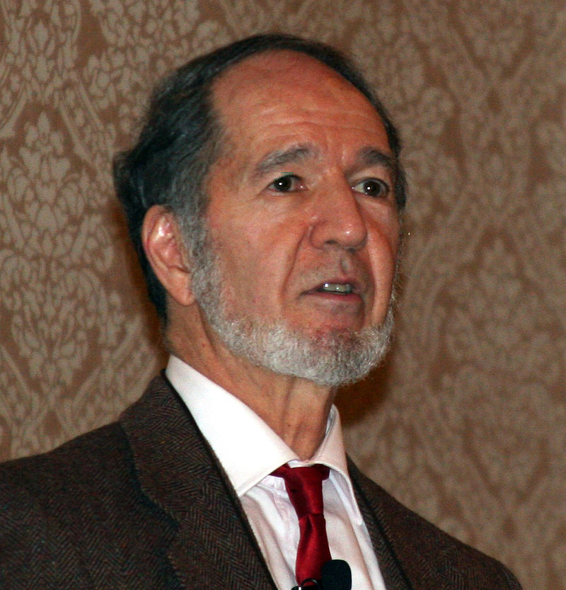
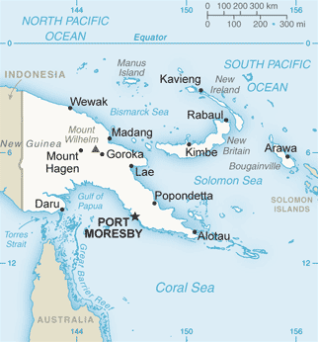
Assembly rules
Diamond (1975) postulates 7 assembly rules based on field observations of 141 species in bird communities in Bismark Archipelago
The rules are mostly based on competition, e.g.:
There are forbidden species combinations
Species occurring together on islands should have reduced niche overlap
Connor & Simberloff (1979) used null models to show that Diamond’s rules do arise in competition-free communities assembled by random colonization
Jared Diamond
Cody & Diamond (1975) Ecology and Evolution of Communities
Notes:
In this panel we can probably all agree that biodiversity is one of the most valuable natural resources.
But things like climate change or habitat loss are a threat to biodiversity, to the extent that we hear about biodiversity crisis, or sixth mass extinction
For example, about 1% of vertebrate species have gone extinct because of humans

Slide 36
Detecting interactions in empirical communities
Gotelli et al. (2010) PNAS
Notes:
In this panel we can probably all agree that biodiversity is one of the most valuable natural resources.
But things like climate change or habitat loss are a threat to biodiversity, to the extent that we hear about biodiversity crisis, or sixth mass extinction
For example, about 1% of vertebrate species have gone extinct because of humans

Slide 37
Common competitors, rare friends
Calatayud et al. (2019) Nature Ecology and Evolution
Hines & Keil (2019) Nature Ecology and Evolution
Notes:
In this panel we can probably all agree that biodiversity is one of the most valuable natural resources.
But things like climate change or habitat loss are a threat to biodiversity, to the extent that we hear about biodiversity crisis, or sixth mass extinction
For example, about 1% of vertebrate species have gone extinct because of humans

Slide 38
You should know
Species associations are analyzed using pairwise similarity calculated between species, not sites.
Similar metrics can be used for species associations, e.g. Jaccard
There are many schools of thought how to approach species associations, and I don’t want you to know all.
The simplest and oldest school of thought uses simple co-occurrence (associations among presences/absences of species)
Diamond used co-occurrence patterns to postulate assembly rules, which in the end haven’t turned out to be that interesting
Gotelli included environmental conditions to the analysis of co-occurrence, and found imprints of species interactions in co-occurrence data in Danish avifauna
Calatayud found, on global scale, that positive interactions occur more often among rare species, while negative interactions (e.g. competition) occur more often among common species = “common competitors & rare friends”
Notes:
In this panel we can probably all agree that biodiversity is one of the most valuable natural resources.
But things like climate change or habitat loss are a threat to biodiversity, to the extent that we hear about biodiversity crisis, or sixth mass extinction
For example, about 1% of vertebrate species have gone extinct because of humans

Slide 39
Thank you. Questions?

